Slide 1
COMP SCI 1103/2103 Algorithm Design & Data Structure Class Hierarchies & Inheritance
School of Computer Science
Notes:
This PowerPoint has been created for you to customise for your course. It can be used for your first lecture with students and uploaded to your MyUni course.
When you have finished customising the slides save as a PowerPoint Show ( .PPS)
Show students where they can access this PowerPoint in the MyUni course.

Slide 2

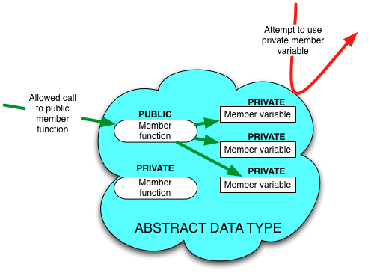
Review
ADT and Black boxes
Interface
Public member functions
Description
Interface is the only thing a user of ADT needs to know
Information hiding
Benefits?
Three rules to make a class an ADT
Notes:
Programmer-defined types, such as the structure types and class types, are not automatically ADTs.
Can change the implementation without disturbing the users.
Can divide work among different programmers or divide larger task into small subtasks
Can prevent the other programmers from doing something bad.

Slide 3
Overview
Class = data + member functions.
Objects = instantiation of a class (class instance)
Design: What to do with similar entities
In this course we will frequently use classes that are very similar to each other, but not quite the same.
Can we use elements of C++ to make this more efficient?

Slide 4
Design
Design a software such that it:
Solves the problem correctly.
Does so efficiently.
Is easy to maintain
Is potentially applicable to other areas.

Slide 5
OO approach
You are familiar with OOP
Identify entities that you should define a class for them
Consider the entity “student”
information : name, address, field, scores, etc
Some functions/behaviors: e.g. calculate GPA

Slide 6
Classes
A class is a template or a blueprint that defines what an object’s data and functions will be.
Objects will call methods on each other.
The methods should be strongly associated with the data of that class.
Practice and experience -> Good design
distinct groupings of variables
Split the desired behavior.
Circle
Class name
-radius:double
-color:string
Data fields
+Circle()
+double getArea()
+void setRadius(double)
Constructors and functions
Notes:
State
behaviour

Slide 7
Splitting the Behavior
Make sure that the separation:
makes sense
efficient

Slide 8
Example
Consider a class of vehicles. There are many common features that all vehicles have.
Variables include:
carrying capacity, number of passengers
Methods include:
add passenger, move vehicle
However, there are also some features that only belong to a certain type of vehicles.

Slide 9
Why hierarchies?
We could write separate classes: Vehicle class, Car class, Bike class, Aircraft class.
Similar properties
Vast duplication of code
Hard to maintain
Why not take a different approach and build classes out of OTHER classes?
The class hierarchy defines the inheritance relationship between the classes.

Slide 10
Example
Consider the Vehicle class
Subclass Cars
Subclass Bikes.
What are the differences between a car and a bike?
How do we model these in terms of:
Variables (data)?
Methods (behaviours)?

Slide 11
Example
Vehicle
Car
Bike
Motor Bike
Pedal Bike
?
Hybrid
The classes are separated based on concepts.
Should be separated based on behaviours.
Notes:
Hybrids include the power assisted pedal cycle, or motorised bicycle?
We’ve made the classic mistake here of not identifying what the behaviours are that we’re trying to separate, we’ve separated based on concepts!

Slide 12
Class Hierarchies
One key problem in constructing a class hierarchy:
focus on the relationships between the concepts (common sense) instead of considering the behaviours and how we should implement them.
Is a Car a separate class near the top or is it just a vehicle with an engine with four wheels?
Are we adding a behaviour or changing a default?
We should design the class hierarchy based on our requirements.
Notes:
Some instances have values different than defaults but are still, for some reason, classified in a very specific way. There are three-wheeled cars, for instance.

Slide 13
Example- separating by behaviors
Engine
Vehicle
Car
Bike
Motor Bike
Pedal Bike
Motorised Bike
What impact does multiple inheritance have on the methods that we choose?
How do we handle this in C++?
Notes:
What does this mean we have to be careful about?
(Answer, namespace management becomes important.)

Slide 14
Class Hierarchies
The class hierarchies that you should form as part of your design must:
solve the problem in hand
be efficient
reduce code duplication
be well-defined and clearly understood
Class hierarchies allow us to build new classes derived from existing classes.
Get it right once, then we can re-use it.
But how do we re-use it?

Slide 15
Inheritance
Inheritance in Object-oriented programming: Derive new classes from existing classes.
Class A extended from class B
Class A : derived class or child class. Class B : base class or parent class
A derived class and its base class must have the is-a relationship.
We usually assume that:
a derived class has extra features
we derive our new class from the most appropriate original class
Class B
Class A
Notes:
We want to have a new class that gives us the maximum functionality for the minimum of added code. Otherwise we’re probably duplicating effort.
As we’ll see, you can redefine and remove functionality from the parent classes.

Slide 16
Example
Why do we have Birds, then Eagles and Parrots?
Animals have heart rates, geographical location and food type.
Birds have wing spans, feather type and egg colours.
Parrots: A rank for their talking ability
Birds are Animals.
Parrots are birds.
Every Bird is an Animal but not every Animal is a Bird!
Animal
Ape
Bird
Eagle
Parrot
Notes:
BEcause birds add things like wings, beak-type, feather-type, but if we started from Eagle and Parrot, we’d have to add all of the these variables and methods to both classes.
Thus, we derive the Birds class from Animals and add all of the common bird behaviours here, then we further derive new subclasses from this and only add those differentiators that are necessary. Do these need to be subclasses or just instances? This decision will be affected by the problem that you’re trying to solve and the domain of interest. For a game? Who cares. For a detailed ornithological survey tool: it may be important.

Slide 17
Family relationships
The derived class Bird is a subclass/child class of Animal.
Animal is a parent class of Bird.
Bird inherits the member functions of Animal.
Animal
Ape
Bird
Eagle
Parrot

Slide 18
Example
GeometricObject
-filled:bool
-color:string
+GeometricObject()
+GeometricObject(string color, bool filled)
+string getColor()
+void setColor(string color)
Circle
Rectangle
-radius:double
-width:double
-height:double
+Circle(double radius)
+Circle(double radius, string color, bool filled)
+double getArea()
+void setRadius(double)
+Rectangle(double width, double height)
+Rectangle(double width, double height, string color, bool filled)
+double getArea()
Notes:
The child class inherits, by default, all public member variables and all public member functions (excluding some specialized member functions, such as constructors, that are not automatically inherited)

Slide 19
Child Class
The child class inherits from the parent:
all public member variables
all public member functions
We can add member functions and variables to the child.
Are these available to the parent?
Are available to children of the child?
We can also redefine (avoid)/override (using virtual) the member functions of the parent as viewed by the child.
NO!
Yes
Notes:
If we define the same function in both the base and the derived classes then we have two options: redefine the function or override the function.

Slide 20
Advantages
Update easily
If the child classes inherit methods from the parent and then we change the parent, all children automatically get access to the new, improved code.
Very, very powerful technique.
We can use the child in places where we could use the parent, although we are restricted to the methods publicly available from the parent.

Slide 21
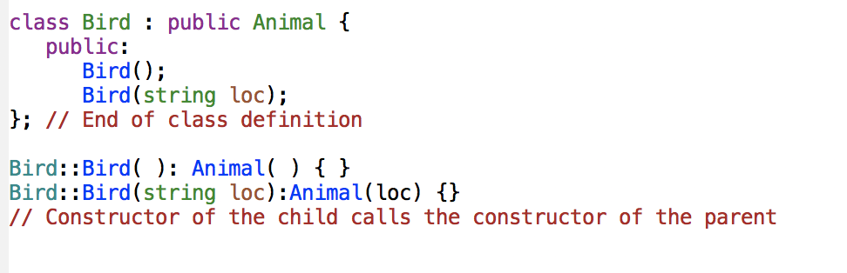
Example
The constructors of a base class are not automatically inherited in the derived class.
One constructor of the base class must be invoked to initialize the variables in the base class
If you don’t name it, the constructor with no argument will be automatically invoked.
Notes:
If we construct a new Bird, then we do any set-up that we need to do in Animal and then we set up the special stuff for Bird. We are taking advantage of previously written code.
A constructor in a derived class must always invoke a constructor in its base class. If a base constructor is not invoked explicitly, the base class’ no-argument constructor is invoked by default.

Slide 22
Notes:
Save as a PowerPoint Show and upload to your MyUni course.
Before you upload the PPS customise slides and indicate where students will find them.

